Slide 1






Spokane County
Residential Market
Trends and Outlook
Karene Loman
Spokane REALTORS®
2025 President

Slide 2

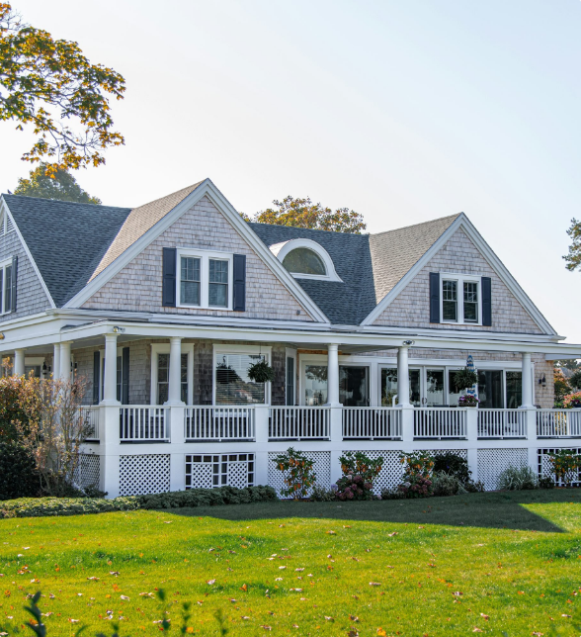


Spokane County
2024 Year End Sales Report
Sales Closed: 5,615
Sales Down: 1.5%
Median Price Up: 20.2%
Inventory Up: 25%
New Listings Up 10.7%
Average Supply of Inventory: 2.3 months
2.

Slide 3
Residential Closed Sales
Spokane County
Source: Spokane REALTORS® Multiple Listing Services (Market Activity Report)
3.

Slide 4
Percent of Change in Residential Closed Sales
Spokane County
Source: Spokane REALTORS® Multiple Listing Services (Market Activity Report)
4.

Slide 5
Residential Median Closed Sales Prices
Spokane County
Source: Spokane REALTORS® Multiple Listing Services (Market Activity Report)
5.

Slide 6
Percent of Change in Median Home Price
Spokane County
Source: Spokane REALTORS® Multiple Listing Services (Market Activity Report)
6.

Slide 7
Residential Average Closed Sales Prices
Spokane County
Source: Spokane REALTORS® Multiple Listing Services (Market Activity Report)
7.

Slide 8
Percent of Change in Average Home Prices
Spokane County
Source: Spokane REALTORS® Multiple Listing Services (Market Activity Report)
8.

Slide 9
Residential New Listings
Spokane County
Source: Spokane REALTORS® Multiple Listing Services (Market Activity Report)
9.

Slide 10
Percent of Change in New Listings
Spokane County
Source: Spokane REALTORS® Multiple Listing Services (Market Activity Report)
10.

Slide 11
Active Listings
Spokane County
Source: Spokane REALTORS® Multiple Listing Services (Market Activity Report)
11.

Slide 12
Closed Sales
Spokane County
Source: Spokane REALTORS® Multiple Listing Services (Market Activity Report)
12.

Slide 13
Median Sales Price
Spokane County
Source: Spokane REALTORS® Multiple Listing Services (Market Activity Report)
13.

Slide 14
Average Sales Price
Spokane County
Source: Spokane REALTORS® Multiple Listing Services (Market Activity Report)
14.

Slide 15


















Historical Interest Rates
Spokane County
17
12
8
4
1983
1985
1987
1989
1991
1993
1995
1997
1999
2001
2003
2005
2007
2009
2011
2013
2015
2017
2019
2021
2023
2025
Source: Bankrate
15.

Slide 16

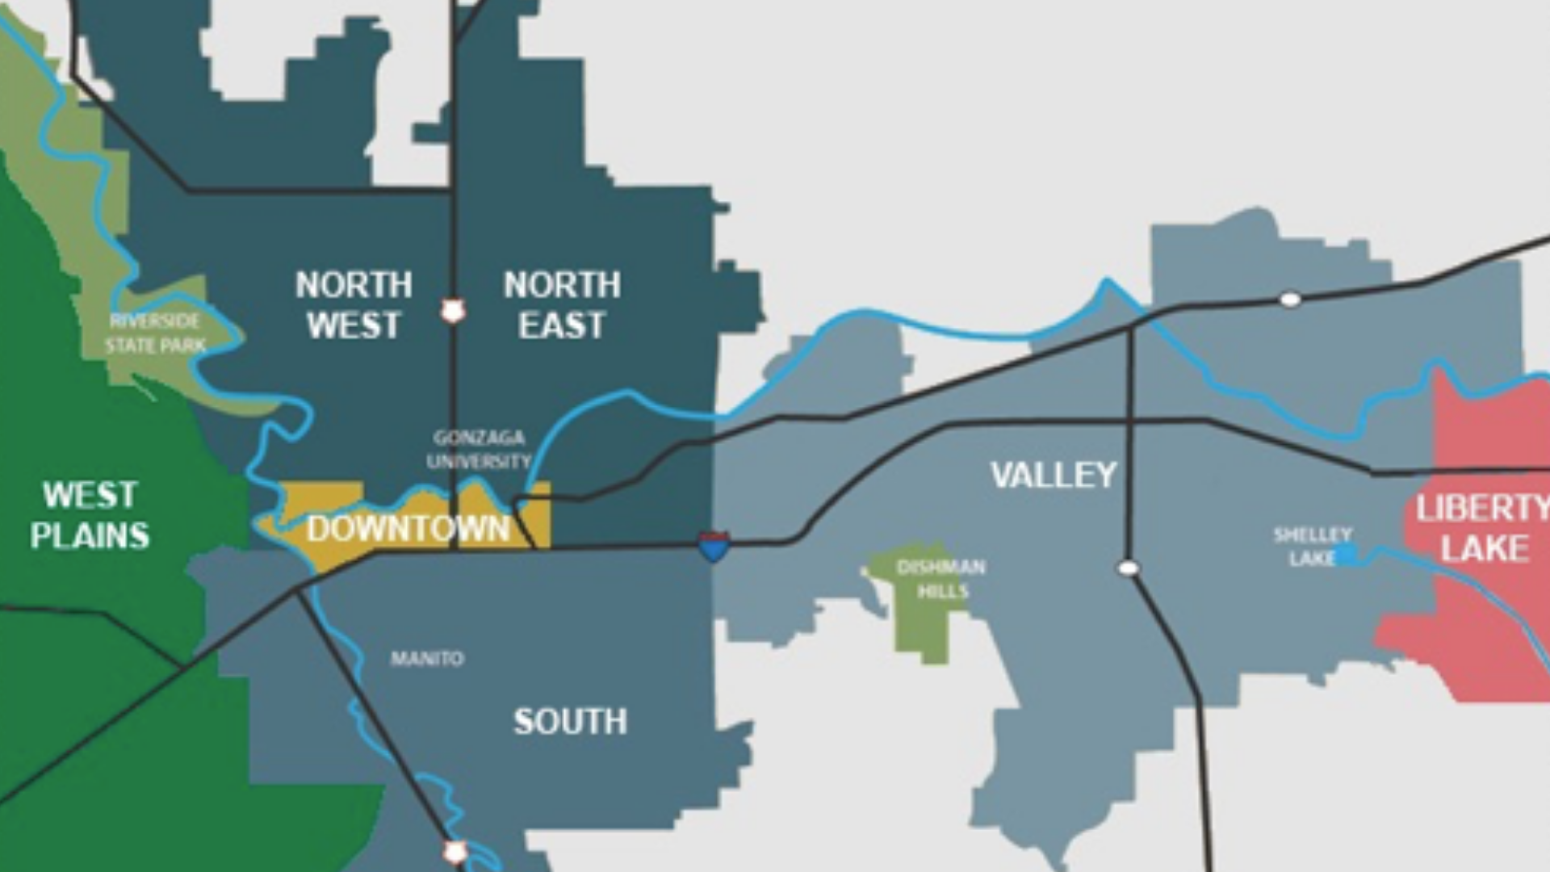

Spokane County
16.

Slide 17
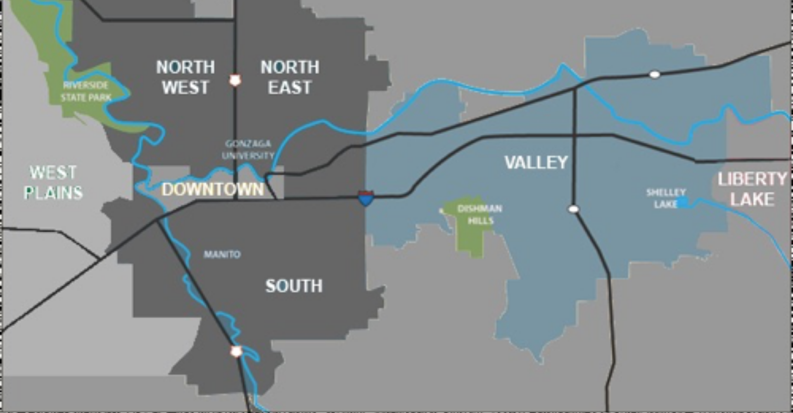


Spokane Valley
Current Months of Inventory: 2.5 Months
2024 Median Closed Sales Price: $455,000 up 1.1%
2024 Closed Sales: 1,673 down 7.4%
17.

Slide 18

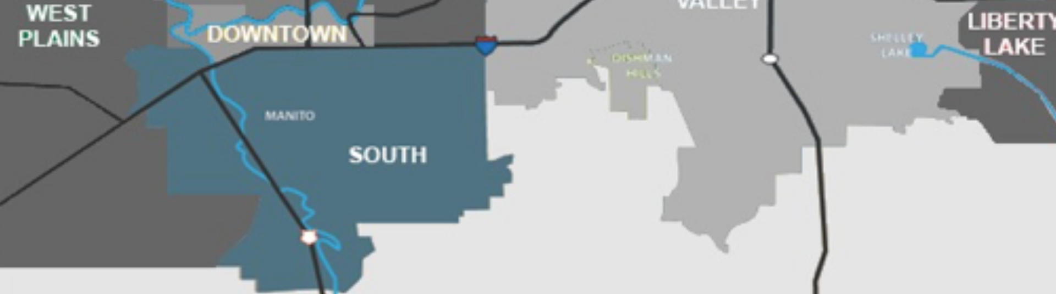
Spokane's South Hill
Current Months of Inventory: 1.9 Months
2024 Median Closed Sales Price: $465,000 up 3.6%
2024 Closed Sales: 1,127 up 4.3%
18.

Slide 19
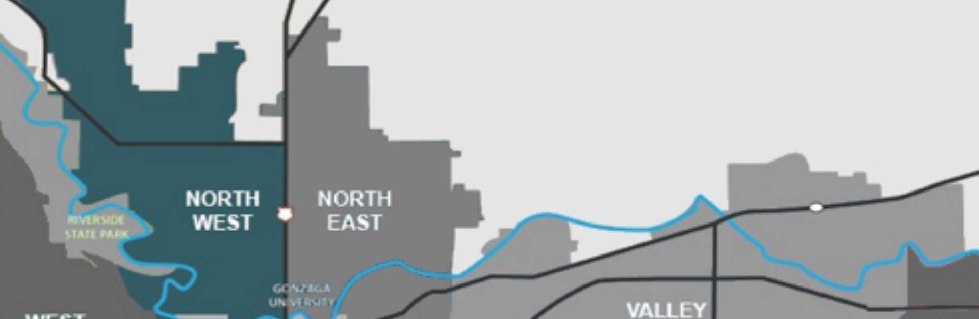

Northwest Spokane
Current Months of Inventory: 1.7 Months
2024 Median Closed Sales Price: $390,500 up 38.3%
2024 Closed Sales: 1,390 down 5.8%
19.

Slide 20
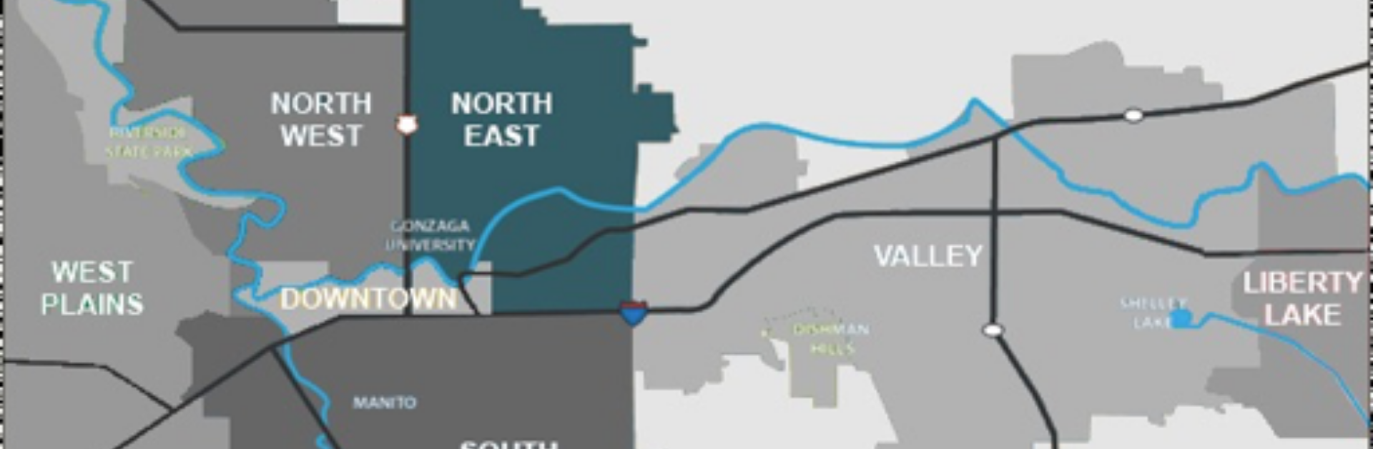
Northeast Spokane
Current Months of Inventory: 2.4 Months
2024 Median Closed Sales Price: $324,900 up 12.1%
2024 Closed Sales: 877 down 5.2%
2024 Median Closed Sales Price: $324,900 up 12.1%
20.

Slide 21
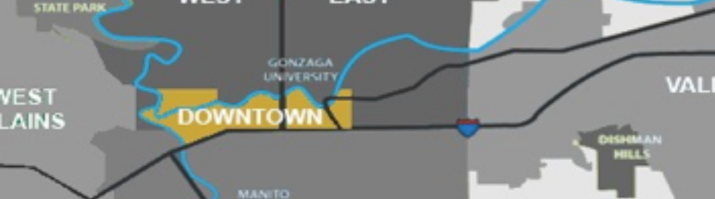
Downtown Spokane
Current Months of Inventory: 6.3 Months
2024 Median Closed Sales Price: $377,500 up 16.5%
2024 Closed Sales: 38 down 9.5%
21.

Slide 22
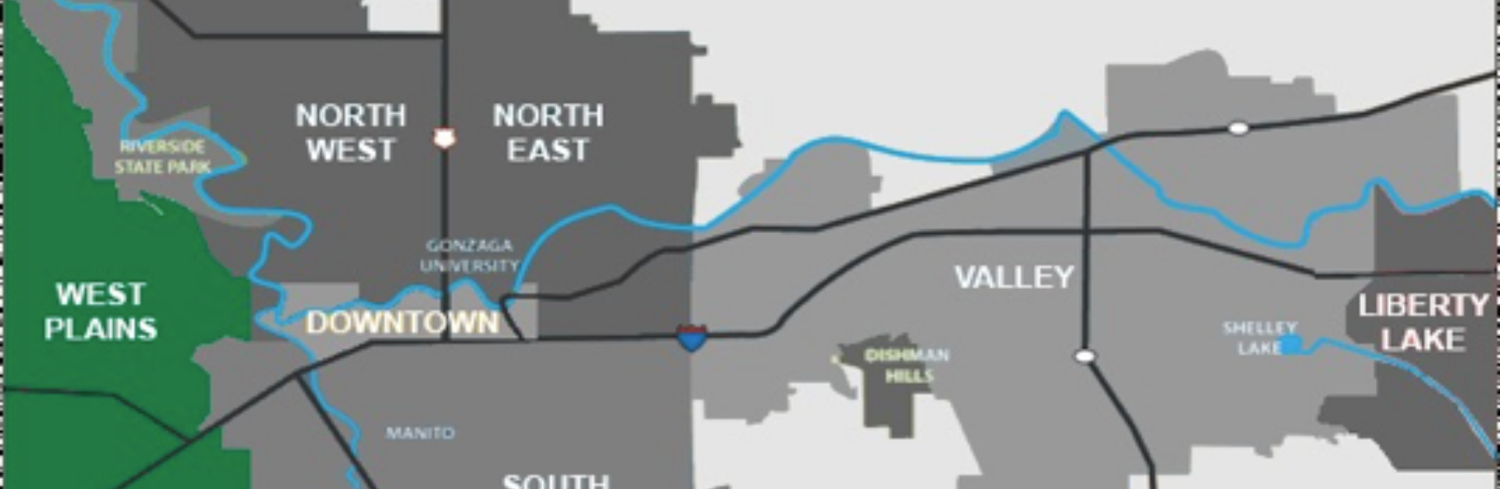
West Plains
Current Months of Inventory: 2.5 Months
2024 Median Closed Sales Price: $399,000 down 0.5%
2024 Closed Sales: 594 up 9.6%
22.

Slide 23


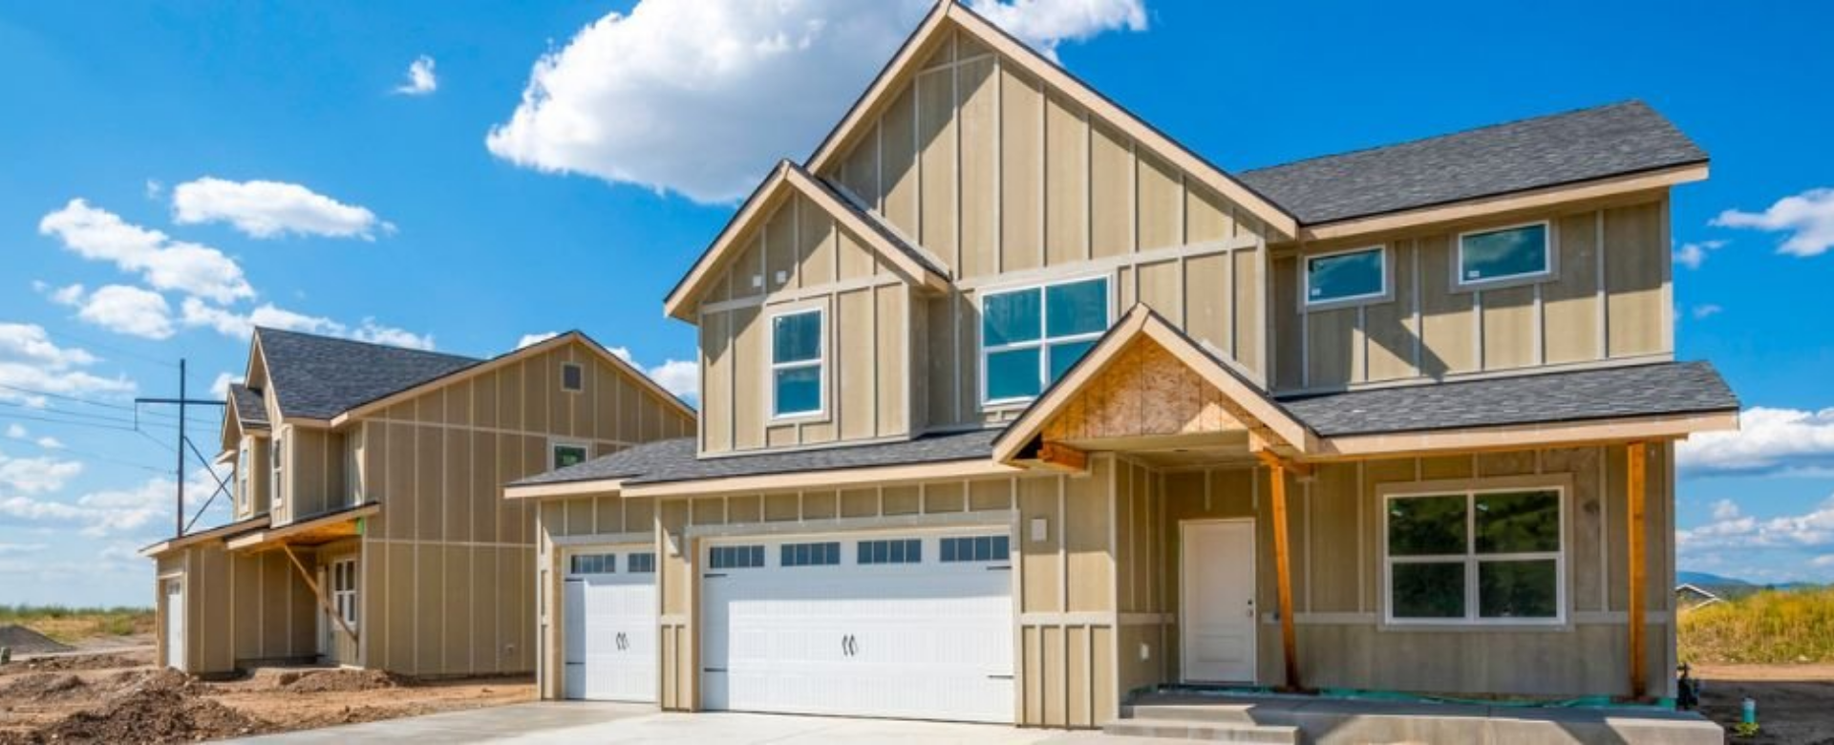
New Construction
23.

Slide 24
New Construction Sales
Spokane County
Source: Spokane REALTORS® Multiple Listing Services (Market Activity Report)
24.

Slide 25
New Construction Median Sales Price
Spokane County
Source: Spokane REALTORS® Multiple Listing Services (Market Activity Report)
25.

Slide 26
New Construction Average Sales Price
Spokane County
Source: Spokane REALTORS® Multiple Listing Services (Market Activity Report)
26.

Slide 27


Spokane Housing Coalition
The Spokane Housing Coalition combines the strength of local housing providers to generate research and advocacy for the purpose of creating more housing opportunities immediately.
27.

Slide 28

Who is looking to buy a home in Spokane County? (next 4 years)
  60% Current Homeowners
  35% Renters
By Age
  32% Men Under 50
  22% Women under 50
  32% Men 50+
  22% Women 50+
Looking to buy based on earnings
  14% Households earning under $50k
  26% Households earning $50-100k
  31% Household earnings $100-150k
  19% Household earnings over $150k
Who Is Looking to Buy?
28.

Slide 29
91% Finding an affordable home
85% Not having a downpayment
79% Full-time job income not enough to buy a home
79% High interest rates
53% Low credit scores
45% Job Security
44% Consumer debt
23% Student loan debt
Renters:
Why they think they can’t buy.
29.

Slide 30
Renters:
How they are looking.
94% Shopped online
75% Improved their Credit Score
50% Saved for a downpayment
53% Talked with a REALTOR®
29% Talked with a loan officer
30.

Slide 31
Desired Housing Types
  65% want a single-family home with a yard
  15% want a condo or townhome
  5% want an ADU (Accessory Dwelling Unit)
  41% would consider a townhome
  33% would consider a condo
Top home shopper preferences
  67% Privacy from neighbors
  52% Larger than average square footage
  58% Size of the yard
  53% Low maintenance yard
Home Details:
What are buyers looking for?
31.

Slide 32
Price Point Desired for Next Home Purchase
  12% Under $200k
  22% $200-$300k
  23% $300-400k
  22% $400-$500k
  10% $500-600k
  11% $600k plus
67% of Buyers are looking for a home priced under $500k ($418,000 is the current
median priced home)
What price ranges are buyers looking?
32.

Slide 33
Relax dimensional standards to encourage the development of small homes and townhomes on small lots.
Simplify short plat regulations encouraging homeownership on small lots.
Relax engineering standards for infill development, including city financial support where infrastructure is deficient at infill locations.
Expedite permit processing for residential development.
Establish a “housing affordability “ goal for every department in the City of Spokane.
Spokane REALTORS®
10-point Solutions
33.

Slide 34
Prioritize surplus City of Spokane properties for housing opportunities.
Consider 99-year leases for development of affordable housing – use the Amazon model.
Discount or eliminate city permit fees and costs for any project that can bring the retail price below $300k – adding a 5-year owner occupancy requirement.
Set aside Multi-Family Tax Exemptions (MFTE) increases into a small fund to assist with water/sewer connections on small projects.
Lobby for GMA Expansion.
Spokane REALTORS®
10-point Solutions
34.

Slide 35
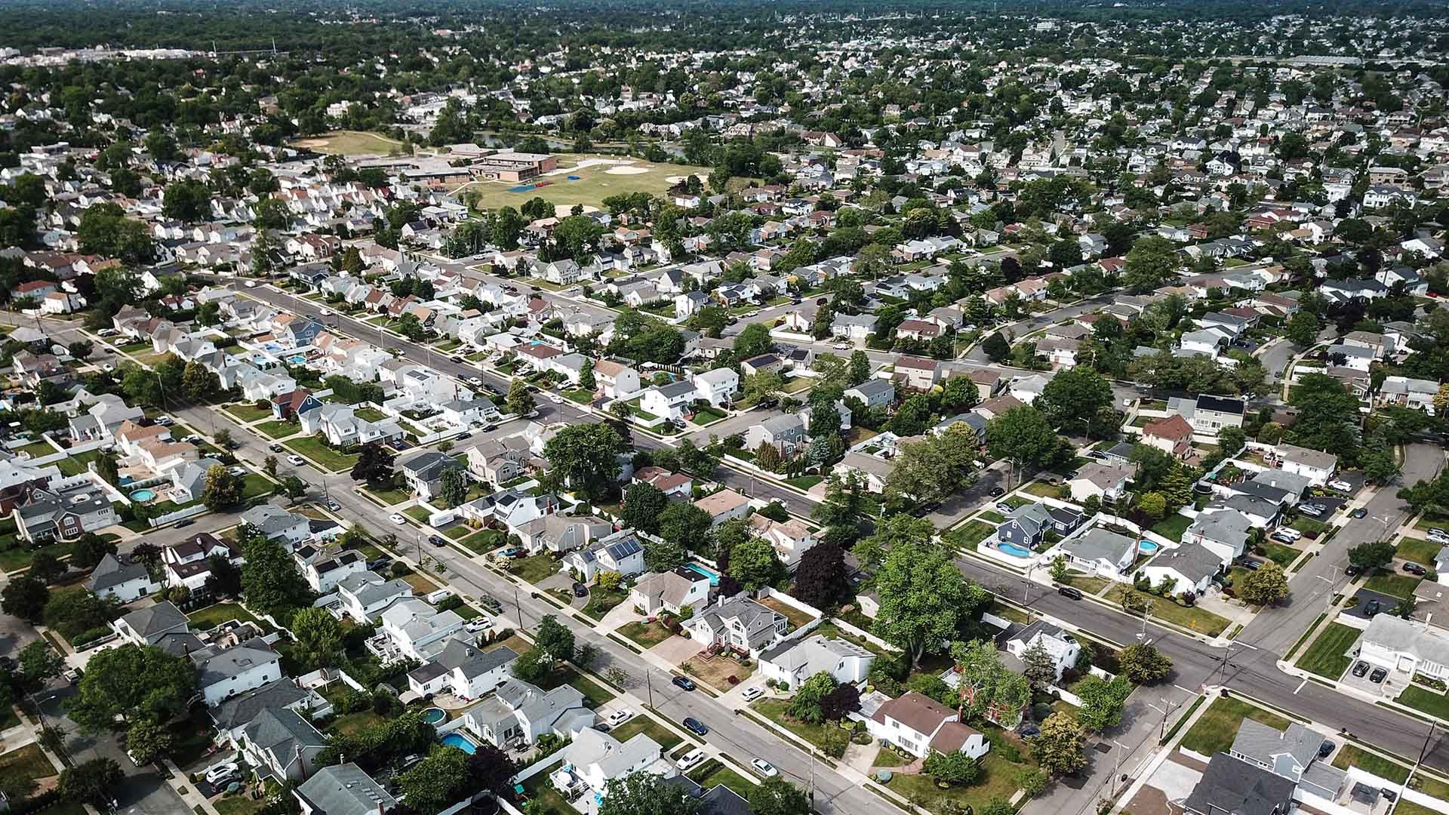

Growth Management Act
35.

Slide 36









2025 Sale Predictions
Key Discussion Points and Presentation Objectives
Units
Price
National Association of REALTORS® (National Market)
+9.0%
+2.0%
Realtor.com (Spokane-Spokane Valley)
-0.4%
+8.7%
Spokane REALTORS®
Hold Steady
+5%
36.

Slide 37






2025 Interest Rate Predictions
Key Discussion Points and Presentation Objectives
Projected Interest Rate
National Association of Home Builders
6.53%
Mortgage Bankers Association
6.50%
Fannie Mae
6.60%
Wells Fargo
6.79%
37.

Slide 38

Lack of Inventory continues to be our #1 issue.
Interest Rates continues to be higher than consumers are used too.
Supply vs. Demand continued appreciation & affordability are
becoming bigger and bigger issue.
Growth Management Plan (GMA) approaches to identifying, assessing, and mitigating project risks.
Key Factors
to Consider
in 2025
38.

Slide 39

Thank
You
Contact Karene @ (509) 990-2525 or Karene@SoarHome.net

